Slide 1


Module 1: R Fundamentals-Data Frames

Slide 2
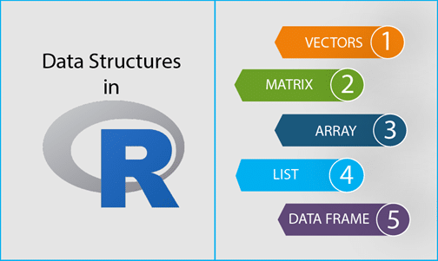

Slide 3
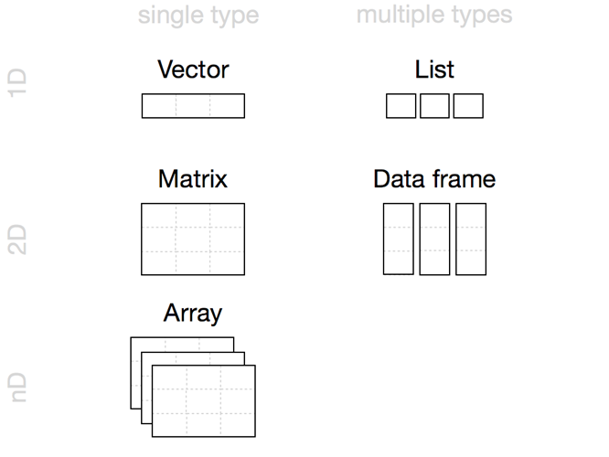
Fundamental Data Structures
Vector
Matrix
Array
A sequence of numbers or characters, or higher-dimensional arrays like matrices
The basic two dimensional data structure in R is the vector
List
A table-like structure (experimental results often collected in this form)
Factor
A sequence assigning a category to each index.
Data.Frame
If a higher dimension vector is desired, then use the function to generate the n-dimensional object.
An ordered set of components stored in a 1D vector
Notes:
Basic data types - R Programming works with numerous data types, including:
environment - hash table. A collection of key-value pairs classes of objects, like expression data, are built from these. Most commands in R involve applying a function to an object.
R’s base data structures can be organized by their dimensionality (1d, 2d, or nd) and whether they’re homogeneous (all contents must be of the same type) or heterogeneous (the contents can be of different types). This gives rise to the five data types most often used in data analysis.
Given an object, the best way to understand what data structures it’s composed of is to use str(). str() is short for structure and it gives a compact, human readable description of any R data structure.
Matrices in R can be thought of as vectors indexed using two indices instead of one.

Slide 4
R Data Frames:
Data frames combine the behavior of lists and matrices to make a structure ideally suited for the needs of statistical data. The data frame is a list of vectors which are of equal length.
A data-frame must have column names and every row should have a unique name.
names(), colnames(), and rownames()
Each column must have the identical number of items.
Each item in a single column must be of the same data type.
Different columns may have different data types.
A matrix contains only one type of data, while a data frame accepts different data types (numeric, character, factor, etc.). This makes it a 2-dimensional structure, so it shares properties of both the matrix and the list.
Notes:
This module we are going to learn about data frames in R; how to create them, access their elements and modify them in your program.
What is a Data Frame?
A data frame is a rectangular collection of variables (in the columns) and observations (in the rows).
Data frame is a two dimensional data structure in R. It is a special case of a list which has each component of equal length.
A data frame is the most important data structure for storing data in R.
A data frame has names(), colnames(), and rownames(), although names() and colnames() are the same thing. The length() of a data frame is the length of the underlying list and so is the same as ncol(); nrow() gives the number of rows.

Slide 5
Functions of data frame
names(x)
[1] "SN" "Age" "Name" “County”
> ncol(x)
[1] 4
> nrow(x)
[1] 2
> length(x) # returns length of the list, same as ncol()
[1] 4

Slide 6
How to create a data frame
We can create a data frame by passing the variable a,b,c,d into the data.frame() function. We can name the columns with name() and simply specify the name of the variables.
data.frame(df, stringsAsFactors = TRUE)
Arguments:
df: It can be a matrix to convert as a data frame or a collection of variables to join
stringsAsFactors: Convert string to factor by default

Slide 7
Check if a variable is a data frame or not
> x
SN Age Name County
1 1 24 Corbin Jefferson
2 2 16 Melanie Montrel
> typeof(x) # data frame is a special case of list
[1] "list"
> class(x)
[1] "data.frame"
Notes:
In this example, x can be considered as a list of 3 components with each component having a two element vector. Some useful functions to know more about a data frame are given below.

Slide 8
x <- data.frame("SN" = 1:2, "Age" = c(24,16), "Name" = c(“Corbin",“Melanie"), “County” = c(“Jefferson”, “Montrel”)
> str(x) # structure of x
'data.frame': 2 obs. of 4 variables:
$ SN : int 1 2
$ Age : num 24 16
$ Name: Factor w/ 2 levels “Melanie”, "Corbin": 2 1
$ County: Factor w/ 2 levels “Montrel”, "Jefferson”: 2 1
Notes:
For example, the above shown data frame can be created as follows.
Notice above that the third column, Name is of type factor, instead of a character vector.
By default, data.frame() function converts character vector into factor.
To suppress this behavior, we can pass the argument stringsAsFactors=FALSE.

Slide 9
x <- data.frame("SN" = 1:2, "Age" = c(24,16), "Name" = c(“Corbin",“Melanie"), “County” = c(“Jefferson”, “Montrel”), stringsAsFactors = FALSE)
# now the third and fourth columns are character vectors
> str(x) # structure of x
'data.frame': 2 obs. of 4 variables:
$ SN : int 1 2
$ Age : num 24 16
$ Name: chr “Melanie”, "Corbin"
$ County: chr “Montrel” "Jefferson”
Notes:
By default, data.frame() function converts character vector into factor.
To suppress this behavior, we can pass the argument stringsAsFactors=FALSE.
Many data input functions of R like, read.table(), read.csv(), read.delim(), read.fwf() also read data into a data frame.

Slide 10
# Example R program to illustrate dataframe
# A vector which is a character vector
Name = c(“Auriel", "Ray", "Asia")
# A vector which is a character vector
Type = c(“O+", “B-”, “A-")
# A vector which is a numeric vector
Age = c(36, 23, 62)
# To create dataframe use data.frame command
# and then pass each of the vectors
# we have created as arguments
# to the function data.frame()
df = data.frame(Name, Type, Age)
print(df)
Notes:
You create a data frame using data.frame(), which takes named vectors as input:
Beware data.frame()’s default behavior which turns strings into factors. Use stringsAsFactors = FALSE to suppress this behavior:

Slide 11
Because a data.frame is an S3 class, its type reflects the underlying vector used to build it: the list. To check if an object is a data frame, use () or test explicitly with is.data.frame():class
typeof(df)
#> [1] "list"
class(df)
#> [1] "data.frame"
is.data.frame(df)
#> [1] TRUE
You can coerce an object to a data frame with as.data.frame():
A vector will create a one-column data frame.
A list will create one column for each element; it’s an error if they’re not all the same length.
A matrix will create a data frame with the same number of columns and rows as the matrix.
Notes:
Example using as.data_frame
S3 class has no formal, predefined definition.
Basically, a list with its class attribute set to some class name, is an S3 object. The components of the list become the member variables of the object.

Slide 12
How to access components of a data frame?
Assessing like a list:
We can use either [, [[ or $ operator to access columns of data frame.
x["Name"]
Name
1 Corbin
2 Melanie
> x$Name
[1] "Corbin" "Melanie"
> x[["Name"]]
[1] "Corbin" "Melanie"
> x[[3]]
[1] "Corbin" "Melanie"
Notes:
Components of data frame can be accessed like a list or like a matrix.

Slide 13
How to access components of a data frame?
Assessing like a matrix:
Data frames can be accessed like a matrix by providing index for row and column.
We can use either [, [[ or $ operator to access columns of data frame.
x["Name"]
Name
1 Corbin
2 Melanie
> x$Name
[1] "Corbin" "Melanie"
> x[["Name"]]
[1] "Corbin" "Melanie"
> x[[3]]
[1] "Corbin" "Melanie"
Notes:
Components of data frame can be accessed like a list or like a matrix.
Accessing with [[ or $ is similar. However, it differs for [ in that, indexing with [ will return us a data frame but the other two will reduce it into a vector.
A data frame can be examined using functions like str() and head().

Slide 14
Merging: Combine data frames using cbind() and rbind()
cbind(df, data.frame(z = 3:1))
#> x y z
#> 1 1 a 3
#> 2 2 b 2
#> 3 3 c 1
rbind(df, data.frame(x = 10, y = "z"))
#> x y
#> 1 1 a
#> 2 2 b
#> 3 3 c
#> 4 10 z
When combining column-wise, the number of rows must match, but row names are ignored.
When combining row-wise, both the number and names of columns must match.
Use plyr::rbind.fill() to combine data frames that don’t have the same columns.
Notes:
Merging data:
Add a Column bind or Row bind
The rbind function can be used to combine several vectors, matrices and/or data frames by rows. To join two data frames (datasets) vertically,

Slide 15
Adding new columns through simple list-like assignments.
> x$State <- c(“KY”, “PA”); x
SN Age Name County State
1 24 Corbin Jefferson KY
2 16 Melanie Montrel PA
Data frame columns can be deleted by assigning NULL to it.
> x$State <- NULL
> x
SN Age Name County
1 24 Corbin Jefferson
2 16 Melanie Montrel
Similarly, rows can be deleted through assignments.
> x <- x [-1,]
> x
SN Age Name County
1 24 Corbin Jefferson
2 16 Melanie Montrel
Notes:
Merging data:
Add a Column bind or Row bind
The rbind function can be used to combine several vectors, matrices and/or data frames by rows. To join two data frames (datasets) vertically,

Slide 16
It’s a common mistake to try and create a data frame by cbind()ing vectors together. This doesn’t work because cbind() will create a matrix unless one of the arguments is already a data frame. Instead use data.frame() directly:
bad <- data.frame(cbind(a = 1:2, b = c("a", "b")))
str(bad)
#> 'data.frame': 2 obs. of 2 variables:
#> $ a: Factor w/ 2 levels "1","2": 1 2
#> $ b: Factor w/ 2 levels "a","b": 1 2
good <- data.frame(a = 1:2, b = c("a", "b"), stringsAsFactors = FALSE)
str(good)
#> 'data.frame': 2 obs. of 2 variables:
#> $ a: int 1 2
#> $ b: chr "a" "b"
Notes:
It’s a function of the language.
The conversion rules for cbind() are complicated and best avoided by ensuring all inputs are of the same type.
Do not cbind vectors. You don’t want the vector as a factor.
You create a data frame using data.frame(), which takes named vectors as input:
Because the df takes on as a vector and factor is derived type from a vector. The stringasfactor is turned true.
Beware data.frame()’s default behavior which turns strings into factors. Use stringsAsFactors = FALSE to suppress this behavior:

Slide 17
Example:
Let's create a factor data frame.
# Create gender vector
gender_vector <- c("Male", "Female", "Female", "Male", "Male")
class(gender_vector)
# Convert gender_vector to a factor
factor_gender_vector <-factor(gender_vector)
class(factor_gender_vector)
Output:
## [1] "character"
## [1] "factor"
Notes:
It is important to transform a string into factor when we perform Machine Learning task.
A categorical variable can be divided into nominal categorical variable and ordinal categorical variable.

Slide 18
Examine a Data Frame in R with 7 Basic Functions
dim(): shows the dimensions of the data frame by row and column
str(): shows the structure of the data frame
summary(): provides summary statistics on the columns of the data frame
colnames(): shows the name of each column in the data frame
head(): shows the first 6 rows of the data frame
tail(): shows the last 6 rows of the data frame
View(): shows a spreadsheet-like display of the entire data frame

Slide 19
Fixing a broken data frame
Some useful functions:
?read.csv
head()
str()
class()
unique()
levels()
which()
droplevels()
Note: For these functions you have to put the name of the data object in the parentheses (i.e. head(CO2)).
Also remember that you can use “?” to look up help for a function (i.e. ?str).

